Slide 1
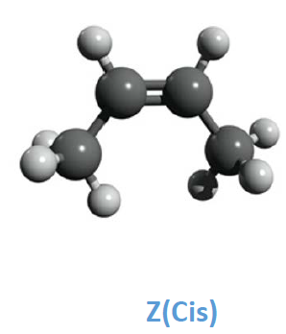
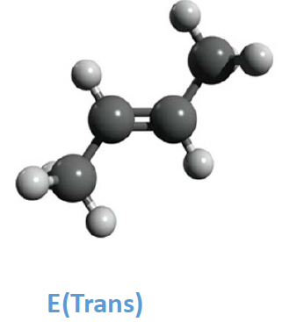
Calculate the optimized structures (Job Type: Opt+Freq) of the E and Z forms of 2- buthene using Hartree-Fock and the DFT (functional WB97X) with the 6-31G(d) basis set (Methods: HF and DFT: WB97X), and make sure to get the lowest energy conformations (Results: Vibrations: no imaginary frequencies) in each case.
Electronic energy buthene HF E -156.10964898
Electronic energy buthene HF Z -156.10710097
Electronic energy buthene DFT E -157.17464049
Electronic energy buthene DFT Z -157.17293366

Slide 2
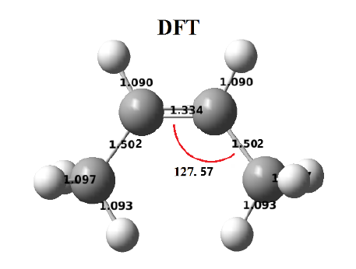
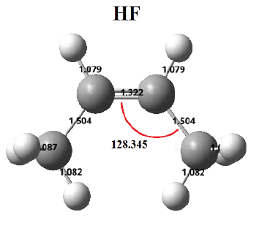

For each level of calculations, compare the optimized geometries of Z form with the experimental values: $R_{C−C}$= 1.506 Å, $R_{C=C}$= 1.346 Å , $θ_{ccc}$ = 125.4°.
Exp $R_{C=C}$= 1.346 $R_{C−C}$= 1.506 $θ_{ccc}$ = 125.4
DFT $R_{C=C}$= 1.334 $R_{C−C}$= 1.502 $θ_{ccc}$ = 127.57
HF $R_{C=C}$= 1.322 $R_{C−C}$= 1.504 $θ_{ccc}$ = 128.34

Slide 3
Perform the energy calculations (Job Type: SP) in both the gas phase and in an implicit water solvent model (Solvation:SMD:Water) and compare the relative energy.
E | gas phase | SMD water | CPCM water
HF | -156.10964898 | -156.10768924 | -156.11166271
DFT | -157.17464049 | -157.17276983 | -157.17671368
Z | gas phase | SMD water | CPCM water
HF | -156.10710097 | -156.10533466 | -156.10921053
DFT | -157.17293366 | -157.17126227 | -157.17509964

Slide 4
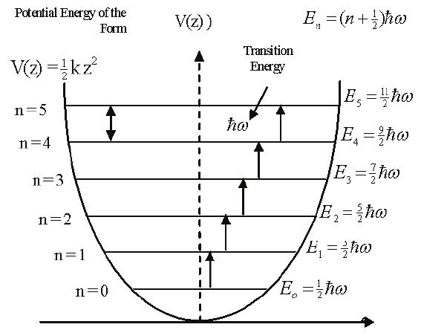
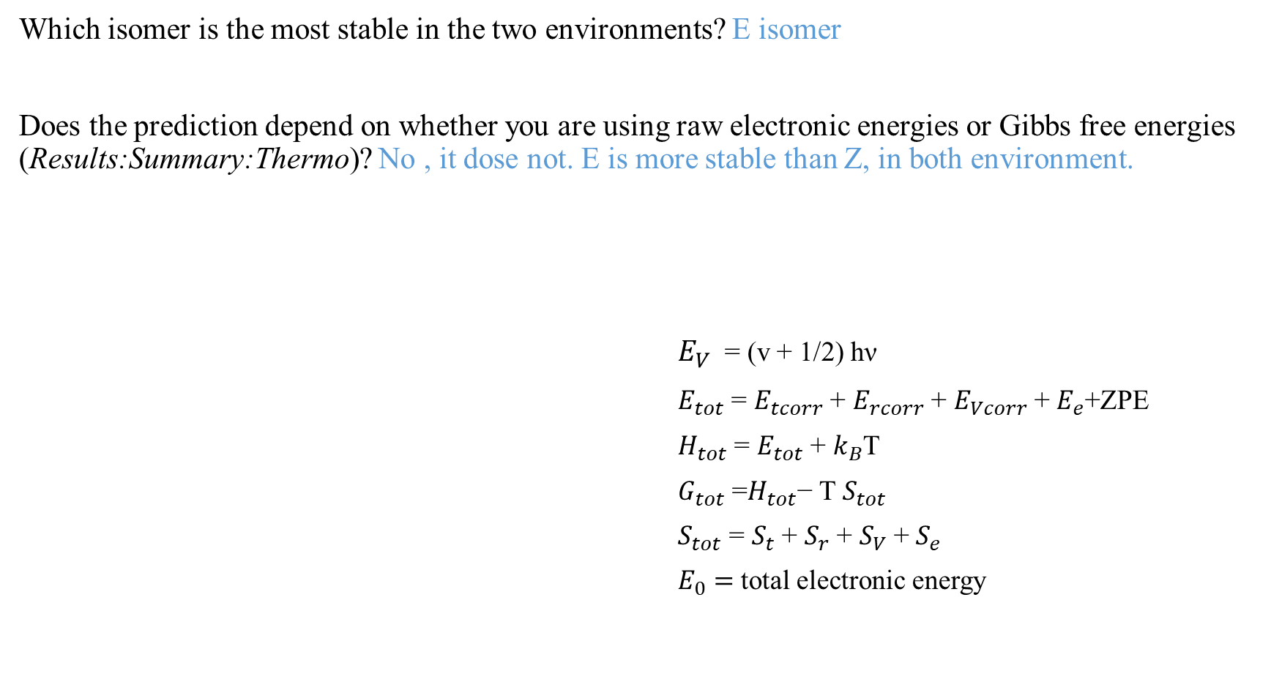
Which isomer is the most stable in the two environments? E isomer
Does the prediction depend on whether you are using raw electronic energies or Gibbs free energies (Results:Summary:Thermo)? No , it dose not. E is more stable than Z, in both environment.
$E_{V}$ = (v + 1/2) hν
$E_{tot}$ = $E_{tcorr}$ + $E_{rcorr}$ + $E_{Vcorr}$ + $E_{e}$+ZPE
$H_{tot}$ = $E_{tot}$ + $k_{B}$T
$G_{tot}$ =$H_{tot}$− T $S_{tot}$
$S_{tot}$ = $S_{t}$ + $S_{r}$ + $S_{V}$ + $S_{e}$
$E_{0}=$ total electronic energy

Slide 5
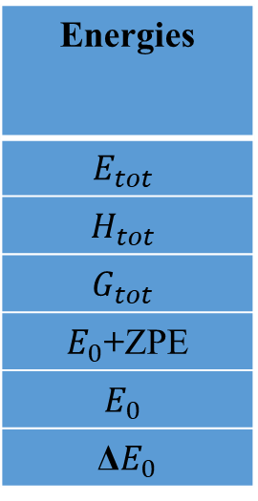
Energies
$$E_{tot}$$
$$H_{tot}$$
$$G_{tot}$$
$E_{0}$+ZPE
$$E_{0}$$
Δ$E_{0}$
In gas phase | In water solvent(SMD) | In water solvent(CPCM)
Z | E | Z | E | Z | E
-155.985956 | -155.988739 | -155.984621 | -155.987153 | -155.988448 | -155.991113
-155.985012 | -155.987795 | -155.983677 | -155.986209 | -155.987503 | -155.990169
-156.018909 | -156.020616 | -156.017797 | -156.019758 | -156.020775 | -156.023657
-155.991262 | -155.994012 | -155.990013 | -155.992457 | -155.993766 | -155.996393
-156.107100 | -156.109648 | -156.105334 | -156.107689 | -156.109210 | -156.111662
6.689 kJ/mol | 6.182 kJ/mol | 6.438 kJ/mol
Sum of the electronic and thermal free energies also show that the E is more stable isomer in two environment.
The total electronic energies show that E isomer has more stability in both gas phase and water solvent about by 6.689 and 6.182 kj/mol respectively.
Δ$E_{0}$ | 4.481 kJ/mol | 3.958 kJ/mol | 4.237 kJ/mol

Slide 6
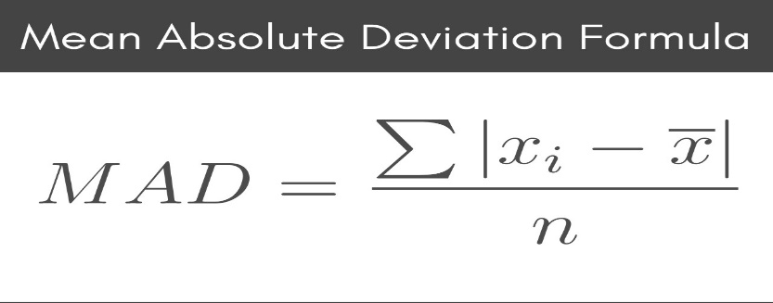
How does the relative stability depend on the polarity of the environment?
Although in gas phase E isomer is more stable than Z, the difference of electronic energies for isomers in polar solvent is more agreement with 3.1 ± 1.6 kJ/mol
How does the calculated value compare to the experimental value?
The results of computational calculations are in agreement with experimental results confirms that E isomer is more stable.
For E form of 2-butene, compare the calculated harmonic vibrational frequencies with the three main high-intensity of experimental anharmonic values by calculating the Mean Absolute Deviations (MAD). This may be easiest to do using a spreadsheet by listing the frequencies and calculating the average absolute differences. What are the trends regarding behavior with respect to level of calculations?

Slide 7
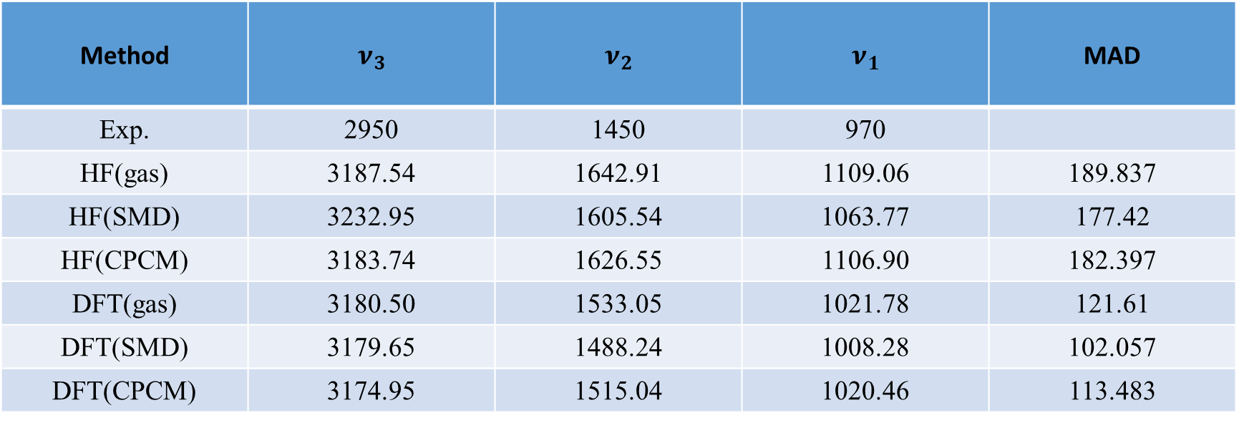
Method | $$ν_{3}$$ | $$ν_{2}$$ | $$ν_{1}$$ | MAD
Exp. | 2950 | 1450 | 970
HF(gas) | 3187.54 | 1642.91 | 1109.06 | 189.837
HF(SMD) | 3232.95 | 1605.54 | 1063.77 | 177.42
HF(CPCM) | 3183.74 | 1626.55 | 1106.90 | 182.397
DFT(gas) | 3180.50 | 1533.05 | 1021.78 | 121.61
DFT(SMD) | 3179.65 | 1488.24 | 1008.28 | 102.057
DFT(CPCM) | 3174.95 | 1515.04 | 1020.46 | 113.483

