Slide 1
Perform calculations for a Li atom using UHF and ROHF wave functions (Method: Unrestricted or Restricted-Open) and the 3-21G basis set with printing of all orbitals
Which of the two calculations gives the lowest total energy?
FINAL SINGLE POINT ENERGY UHF -7.381513263724
FINAL SINGLE POINT ENERGY ROHF -7.381510978774
Difference of energy ΔE = 0.000002285 a.u.(0.001434 kcal/mol)
Why must this necessarily be the case?
UHF allows different spatial orbital for different electron and no constraints on the variational parameters. So the energy of UHF is lower or equal to R(O)HF wave function.

Slide 2
Compare the orbital energies for the 1s- and 2s-orbitals for the ROHF and UHF cases,and the corresponding MO coefficients. How different are the a and b parts of the UHF orbitals compared to the ROHF ones in terms of MO-coefficients?
ORCA | 𝜀 1s (1s’) | C 1s (1s’) | 𝜀 2s | C 2s
ROHF | -2.45222 | -0.990823 | -0.19443 | 0.375063
UHF | -2.46051(-2.44387) | -0.991216(-0.990742) | -0.19443 | 0.375193
GAUSSIAN | 𝜀 1s (1s’) | C 1s (1s’) | 𝜀 2s | C 2s
ROHF | -2.449 | 0.9908 | -0.0526 | 0.3751
UHF | 2.460(-2.444) | -0.9912(0.9907) | 0.1944 | 0.3752

Slide 3
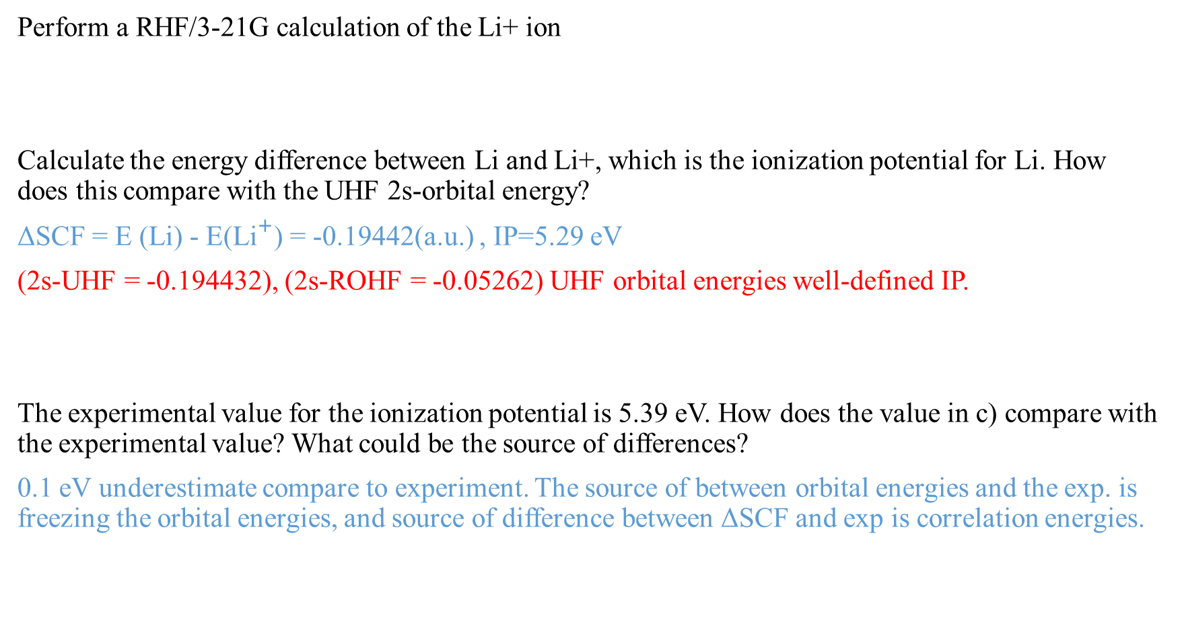
Perform a RHF/3-21G calculation of the Li+ ion
Calculate the energy difference between Li and Li+, which is the ionization potential for Li. How does this compare with the UHF 2s-orbital energy?
ΔSCF = E (Li) - E(${\text{Li}}^{+}$) = -0.19442(a.u.) , IP=5.29 eV
(2s-UHF = -0.194432), (2s-ROHF = -0.05262) UHF orbital energies well-defined IP.
The experimental value for the ionization potential is 5.39 eV. How does the value in c) compare with the experimental value? What could be the source of differences?
0.1 eV underestimate compare to experiment. The source of between orbital energies and the exp. is freezing the orbital energies, and source of difference between ΔSCF and exp is correlation energies.

